Slide 1


SIGN2TEXT APP
CS6811 - Project Work
University Review​
Team no. T23
Date:02/06/2023
Presented by
TEAM AUDACIOUS
Sangeetha D- 311020104069
Rowan Lourdes J - 3110201064
Shyamily R - 311020104077
Nitisri T S- 311020104057
Supervisor
DR ANAND R
Associate Professor
2022-2023

Slide 2
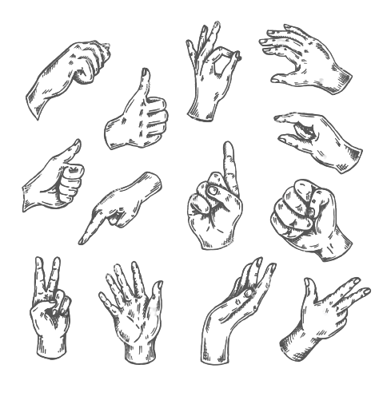
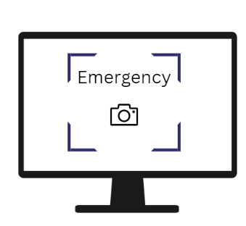

Objective
The Sign Gestures to Text Conversion Web App aims to bridge communication barriers between those who use sign language and those who do not.
It translates sign language gestures into written text, making communication faster and easier when an interpreter is not available.
This app improves accessibility and inclusivity for the deaf or hard of hearing, helping them communicate effectively in various settings.

Slide 3
Introduction/Domain Description
Assistive technology refers to any device, equipment or software that is designed to help people with disabilities to perform daily activities or to improve their quality of life. These technologies are designed to enhance the functional capabilities of people with disabilities and to help them to achieve greater independence, productivity and participation in society. Assistive technology can be used in various domains such as education, communication, mobility, employment, and recreation. Examples of assistive technologies include mobility aids, hearing aids, communication devices, vision aids, and computer software. The goal of assistive technology is to empower people with disabilities to live more independently and to participate more fully in society.

Slide 4
Problem Definition /Abstract
Assistive Technology:
Web App - Gesture language to text convertor Web app.
Sign language is one of the oldest and most natural form of language for communication, but since most people do not know sign language and interpreters are very difficult to use.
Because of this many disabled persons find difficult to communicate with other peoples mainly due to this language barrier
.
Hence our team come up with an Assistive Technology related “web app” which convert sign language(gestures) to English Text( and in speech format).
This Web app can be opened online and by using image capturing technology and machine learning we train the model to convert the hand movement captured from camera to text.

Slide 5
Base Paper
Deep ASLR: A CNN based human computer interface for American Sign
Language recognition for hearing-impaired individuals
Contribution | Aimed to develop an American sign language recognition dataset and use it in the deep learning model which depends on neural networks to interpret gestures of sign language and hand poses to natural language.
Methodology | American Sign Language ASL depicts each letter with a static sign using the hand, except for J and Z. CNN requires less preprocessing than other image classification algorithms and uses four types of operations: convolution, pooling, flattening, and fully connected layers.
Outcome | In this study, they developed an application for American sign language alphabet recognition in real-time. The OpenCV library was used to capture video due to its performance and robustness.
Challenges | The ASLA dataset presents challenges in identifying letters due to varying lighting and distance, such as the size, position, shape, background, lighting, and distance of the hand from the camera.
Future Scope | Future work may be carried out aiming to convert the ASL to commands which robots or machines can understand and execute. In this situation, any person may stand in front of the robot and give commands to it by ASL.

Slide 6
Supporting Paper 1
Convolutional Neural Network based Bidirectional Sign Language Translation System
Contribution | A bidirectional sign language translation system using convolutional neural networks (CNNs) for feature extraction from sign language images. The system integrates both spatial and temporal features and outperforms other state-of-the-art sign language recognition systems.
Methodology | Gestures are interpreted by the flex sensor and accelerometer, which are sent to an android application where the text is converted to speech.
Outcome | the translation of each alphabet in the American Sign Language to text has been implemented via hardware gloves.
Challenges | The prototype glove can predict many gestures correctly but there is a conflict between sensors values for some gestures such as ‘M’, ‘S’, ‘T’ and ‘E’ because of very close proximity in the gesture
Future Scope | TensorFlow lite can be used to build an application and integrate Bluetooth application for text to speech conversion. Gestures can be identified by video classification algorithms to make the system a complete ecosystem.

Slide 7
Supporting Paper 2
Sign Language Recognition System using Convolutional Neural Network and Computer Vision
Contribution | Development of a robust and efficient hand gesture recognition system based on a CNN architecture that can accurately recognize sign language gestures in real-time.
Methodology | The system captures hand gestures with a web camera, processes images with color extraction, segmentation, and morphological operations. It has a dataset of 2000 American sign gesture images, with 80% for training and 20% for testing. Binary pixels are extracted and a Convolutional Neural Network predicts alphabets after evaluation.
Outcome | In this study, the user must be able to capture images of the hand gesture using webcam and the system shall predict and display the name of the captured image. We use the HSV colour algorithm to detect the hand gesture.
Challenges | Sign languages are very broad and differ from country to country in terms of gestures, body language and face expressions. Learning and capturing the gestures was quite a challenge since the movement of hands had to be precise and on point
Future Scope | To improve the model's ability, consider expanding the dataset to include more alphabets. Integrating speech recognition can enhance the system's accessibility for blind individuals, while maintaining a high level of accuracy.

Slide 8
Inference of Literature Review
Base Paper | The literature review emphasizes the growing need for accurate ASL recognition systems for hearing-impaired individuals due to the limitations in accuracy and efficiency of traditional methods. The proposed Deep ASLR system, based on CNN, has the potential to address these limitations and significantly improve ASL recognition performance.
Supporting Paper 1 | The literature review summarizes the current state-of-the-art in sign language recognition and translation, highlighting challenges such as lack of standardization and regional variations. It also discusses the effectiveness of CNNs in recognizing sign language gestures and their potential for bidirectional translation systems.
Supporting Paper 2 | The literature review describes a system that uses computer vision and deep learning to recognize American Sign Language (ASL) gestures and convert them into text or speech. The system has three components: hand detection, hand tracking, and sign classification.

Slide 9
Requirement Specification
Software
FRONT END TOOLS | CSS
BACK END TOOLS | Python, Flask
MARKUP LANGUAGES | HTML
SCRIPTING LANGUAGES | Nil
MIDDLEWARE TECHNOLOGIES | Nil
IDE | Visual studio,Pycharm
SIMULATION TOOLS | Nil
NETWORK/WIRELESS TECHNOLOGIES | Nil
ANY OTHER | Nil
Hardware: nil

Slide 10
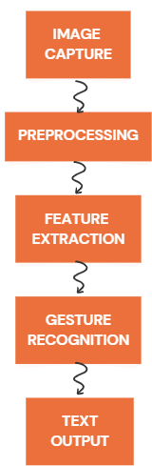
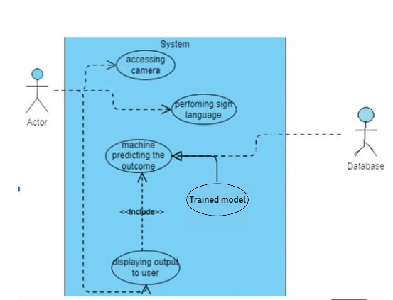
Project Description
USE CASE DIAGRAM
PROCESS

Slide 11
Project Description
Image/Video Capture:
Utilize OpenCV library to capture live video frames from a webcam.
Enable users to perform hand gestures in front of the camera, which will be processed for recognition and translation.
Preprocessing:
Perform image processing techniques, such as color space conversion and flipping, to enhance the captured frames.
Prepare the frames by converting them to the appropriate format for further analysis and feature extraction.
Feature Extraction:
Employ the MediaPipe library and OpenCV to extract hand landmarks and features from the preprocessed frames.
Extract relevant information about the position, shape, and movement of the hand to characterize different gestures.
Gesture Recognition:
Train a Support Vector Machine (SVM) classifier using scikit-learn library on a labeled dataset of hand gestures.

Slide 12
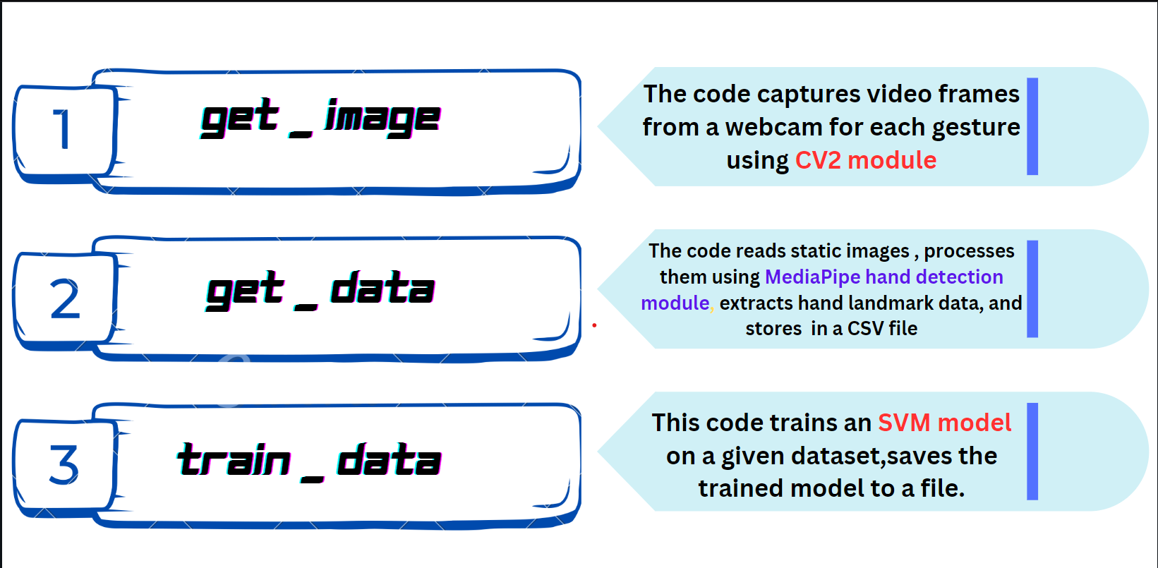
Model Creation

Slide 13
Modules Used
CV2 - OpenCV package
Media Pipe package
NumPy package
Pandas package
Sklearn
CV2 module provides functions and tools for image and video processing, feature detection, object recognition, and various other computer vision tasks.
It is used for hand tracking and gesture recognition in computer vision applications
It is used for array manipulation, data storage, and efficient numerical computations of output hand landmarks
Pandas is used for reading and manipulating the dataset in CSV format, renaming columns, splitting the dataset into features and labels, and creating a data frame.
provides tools for data preprocessing, feature selection, model selection, and other machine learning utilities

Slide 14
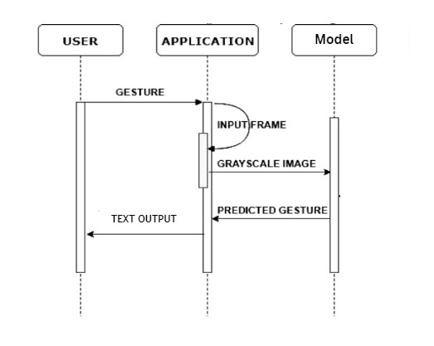
SEQUENCE DIAGRAM

Slide 15
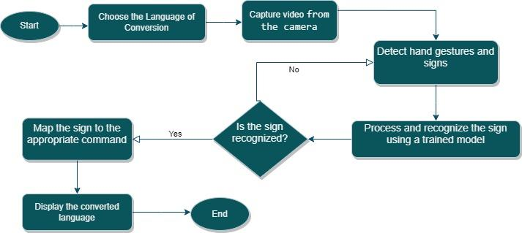
FLOW CHART

Slide 16
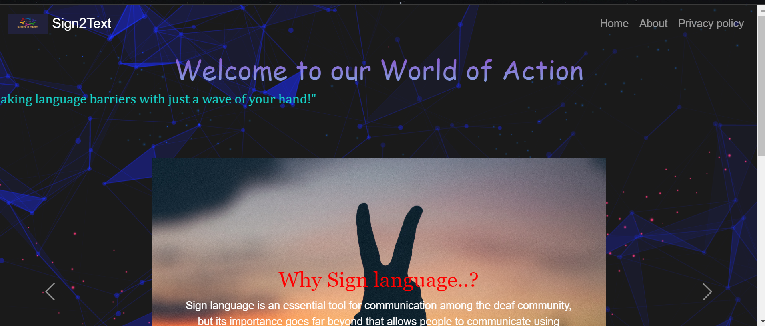
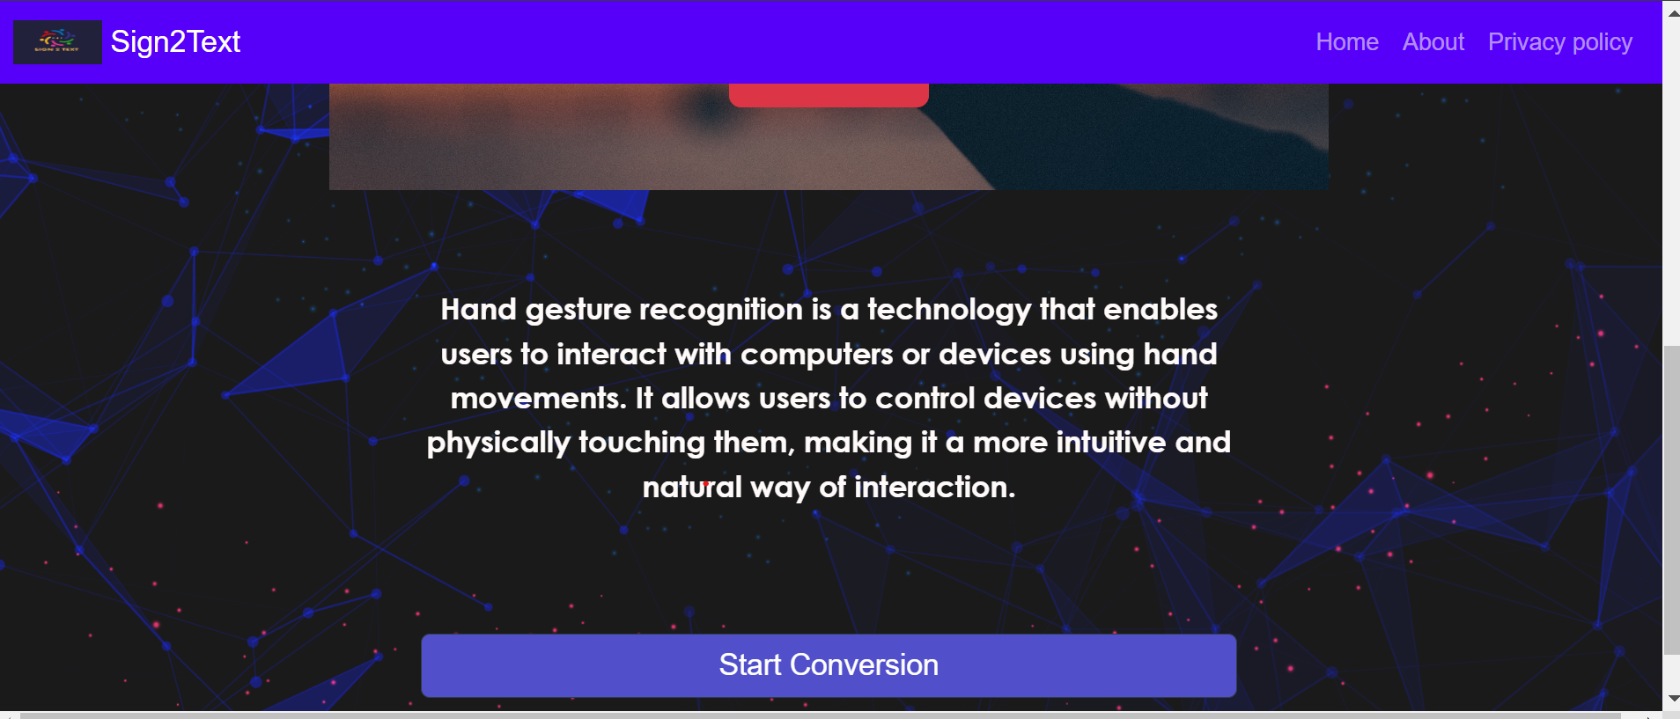
Output

Slide 17
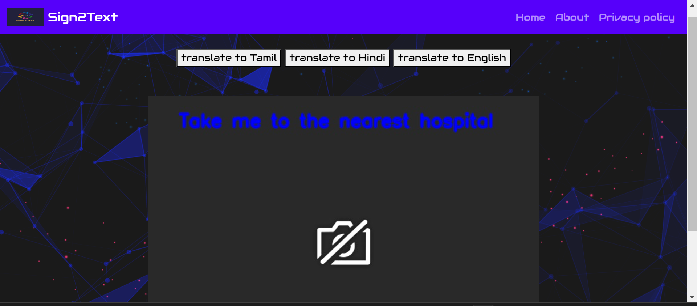
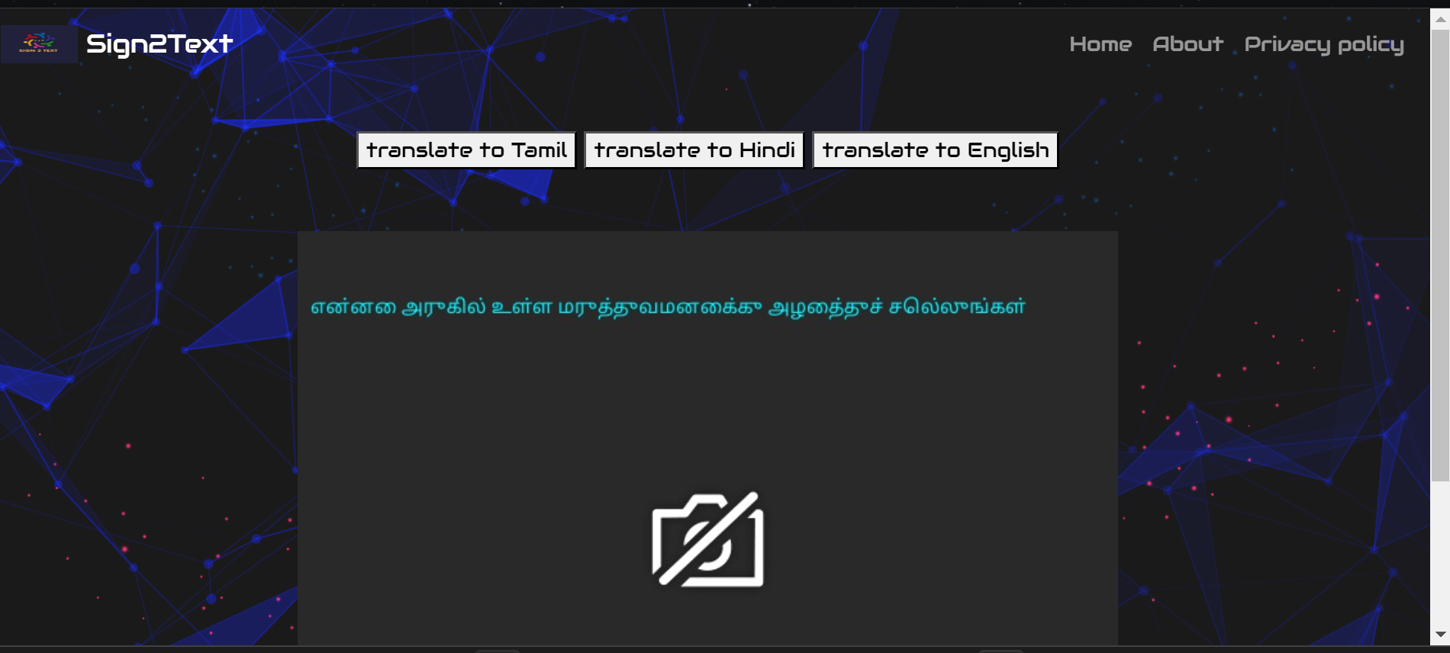
Output

Slide 18
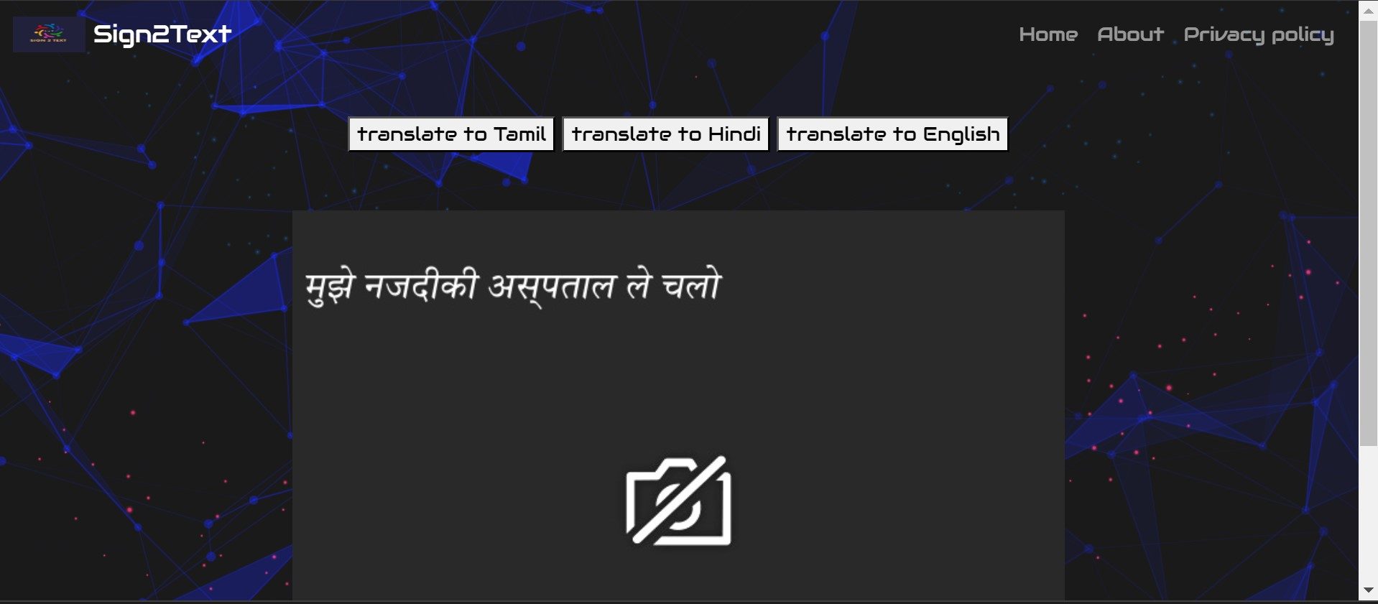
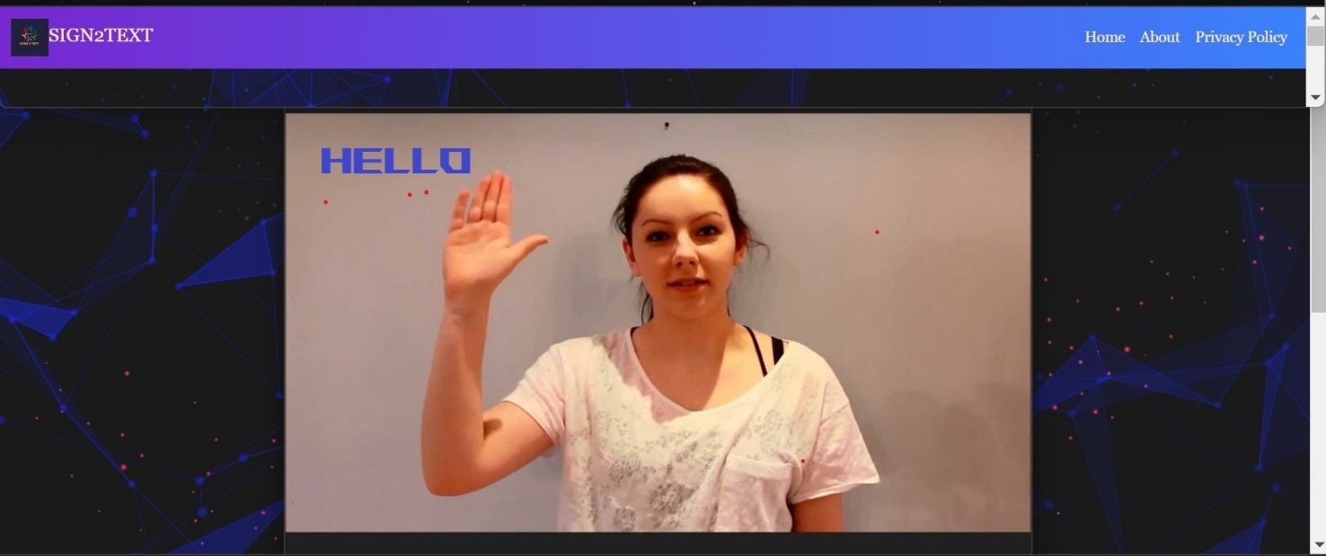
Output

Slide 19
Future Scope
Real time conversion of sign gesture to text.
Improving accuracy to make the Web app more useful and user-friendly.
Educate users on sign language through tutorials, quizzes.
Integrate with voice assistants for hands-free control.
It can incorporate a sign language dictionary to search for signs and learn their meanings and usage.

Slide 20
Conclusion
In conclusion, the hand gesture to text conversion Web app is a promising assistive technology that can greatly benefit individuals with physical disabilities or communication difficulties.
This Web app uses computer vision and machine learning algorithm to translate hand gestures into text, allowing users to communicate more easily and efficiently.
This Web app represents an exciting development in assistive technology and has the potential to transform the lives of many individuals with disabilities.
As technology continues to advance, we can expect to see further improvements and innovations in this field.

Slide 21
References
Base paper
Title – Deep ASLR for hearing-impaired individuals
Author - Ahmed kasapbasi Year – 2022
Link - https://www.sciencedirect.com/science/article/pii/S2666990021000471
Supporting Paper 1
Title – Convolutional Neural Network based Bidirectional Sign Language Translation System
Author - Lance Fernandes Year – 2020
Link : https://ieeexplore.ieee.org/document/9214272
Supporting paper 2
Title - Sign Language Recognition System using CNN and Computer Vision
Author - Mehreen Hurroo Year – 2020
Link - https://ieeexplore.ieee.org/document/9214272

Slide 22
THANK YOU

